Slide 1




NEXT GEN EMPLOYABILITY PROGRAM
Creating a future-ready workforce
Team Members
College Name
Student Name :Thrisha.V
Student ID :511321104103
Kingston Engineering College

Slide 2

CAPSTONE PROJECT SHOWCASE
Project Title
Building Bus Reservation System using Python and Django
Abstract | Problem Statement | Project Overview | Proposed Solution | Technology Used | Modelling & Results | Conclusion

Slide 3
Problem Statement
To create a Bus Reservation system using Python and Django
Source :

Slide 4
Project Overview
The Bus Reservation System is a web-based application developed using Python and Django framework. It aims to provide an efficient and user-friendly platform for users to search for buses, book seats, and manage their reservations conveniently.
Source :

Slide 5
Proposed Solution
Introduction :
The proposed Bus Reservation System aims to provide a comprehensive and user-friendly platform for booking bus tickets online. It will streamline the process of bus reservation for both users and administrators, ensuring efficiency, reliability, and convenience.
Key Features :
User Authentication: The system offers user authentication functionalities allowing users to sign up, log in, and log out securely.
Bus Search: Users can search for available buses based on their origin, destination, and date of travel.
Seat Selection: After finding an available bus, users can select seats from the layout of the bus displayed on the system.
Reservation: Users can make reservations for selected seats, ensuring their seats are confirmed for the desired journey.
Booking Management: Users can view and manage their booking details including the bus details, seat numbers, and reservation status from their dashboard.
Admin Panel: Administrators have access to an admin panel where they can manage buses, seats, users, and reservations efficiently.
.
Source :

Slide 6
Implementation Steps:
Project Setup: Set up a Django project and create necessary directories and files for the application structure.
Database Design: Design the database schema including tables for users, buses, seats, reservations, and any other relevant entities.
Backend Development: Develop backend logic for user authentication, bus management, seat selection, reservation handling, and integration with payment gateways.
Frontend Development: Design and implement frontend interfaces for user interaction, incorporating features such as bus search, seat selection, and reservation management.
Integration: Integrate frontend and backend components, ensuring seamless communication via RESTful APIs.
Testing: Perform thorough testing to validate the functionalities, including user authentication, bus search, seat selection, reservation handling, and payment processing.
Deployment: Deploy the application on a web server, ensuring scalability, security, and performance optimization.
Monitoring and Maintenance: Monitor the application's performance, address any issues or bugs, and incorporate user feedback for continuous improvement.
Source :

Slide 7
Project Structure :
The project is organized into various components:
Models: Define the data models for buses, seats, users, and reservations.
Views: Handle user requests, process data, and render appropriate responses.
Templates: Contains HTML templates for rendering user interfaces dynamically.
Static Files: Store static files such as CSS stylesheets, JavaScript scripts, and images.
Admin Panel: Provides administrative functionalities for managing the system's backend.
Forms: Define forms for user input validation and data submission.
URL Configuration: Maps URL patterns to views and defines routing logic.
Source :

Slide 8


Technology Used
Front-end
Back-end
Source :

Slide 9
Modelling & Results
Modeling Overview
User Model: Stores information about registered users including username, email, password, etc.
Bus Model: Represents details about each bus such as bus number, origin, destination, departure time, and total seats available.
Seat Model: Defines the layout and status of seats for each bus including seat number, availability, and reservation status.
Reservation Model: Associates users with their booked seats, storing information like reservation date, status, and associated bus and seat details.
Results Overview
User Interaction
Bus Search and Reservation
Booking Management
Admin Panel
System Performance
The results overview are effective and robust in handling and validating the application without any unexpected crashes and data inconsistencies.
Source :

Slide 10
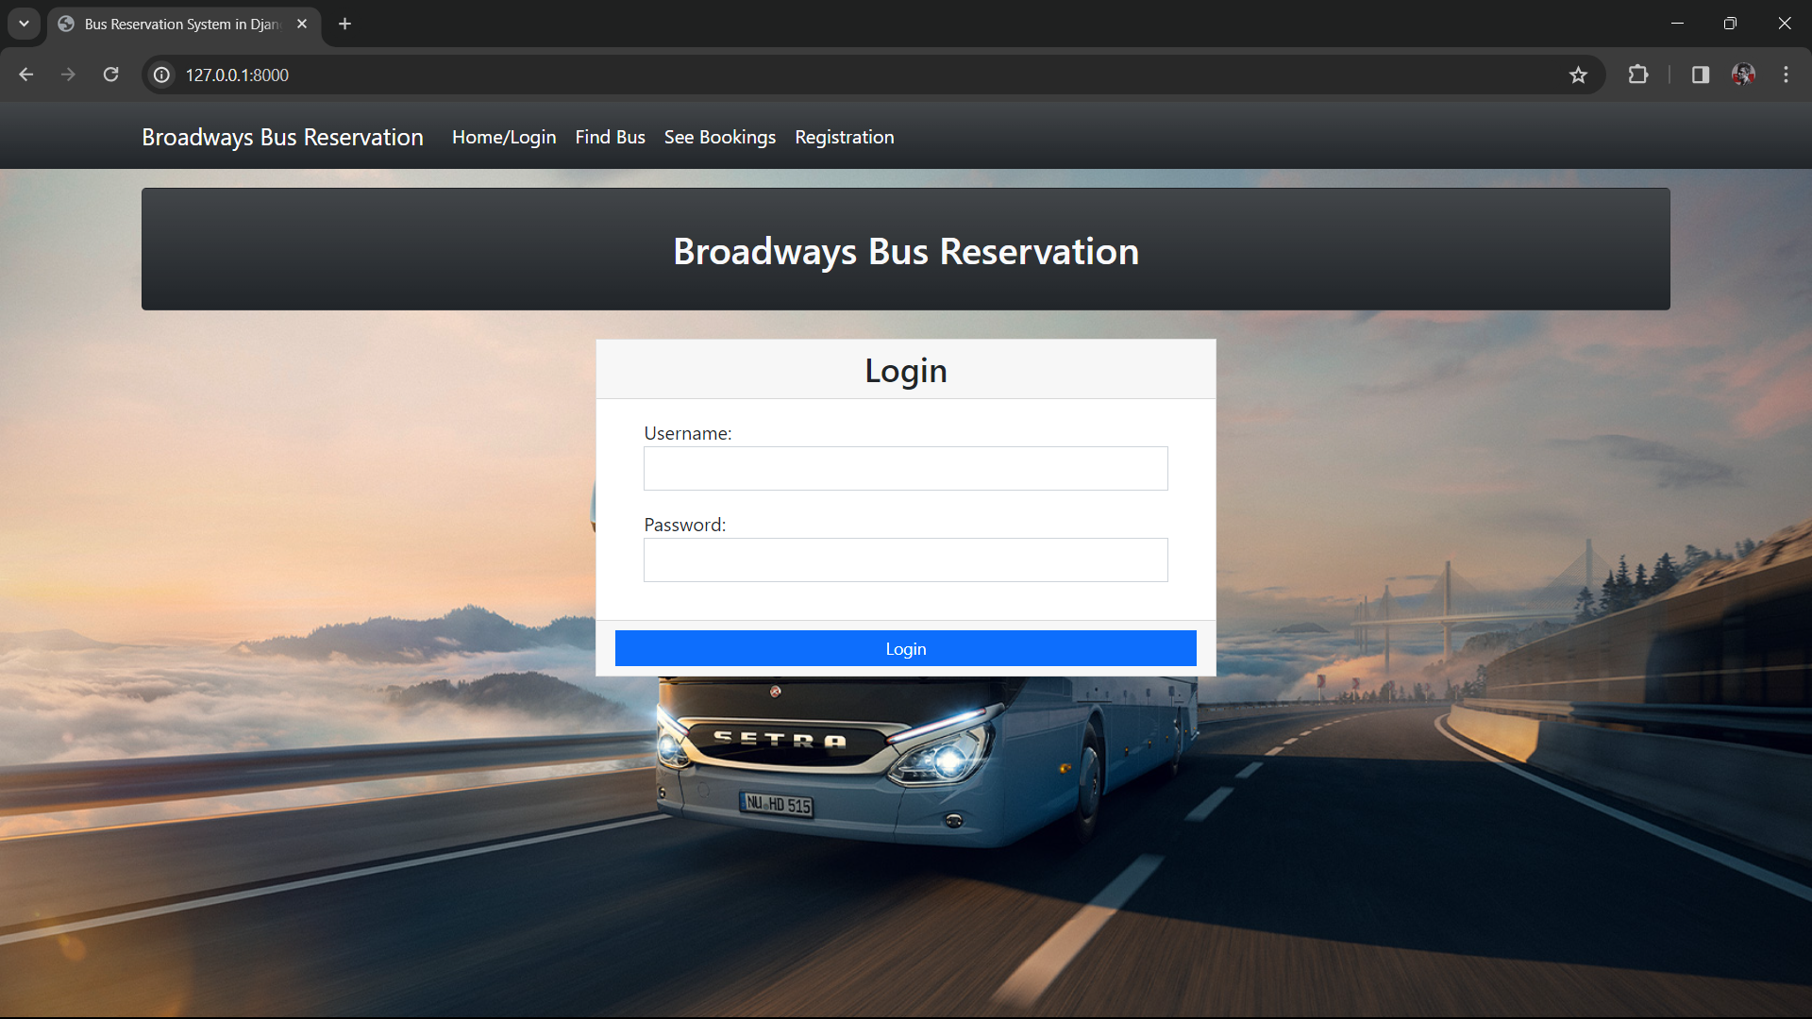
Homepage

Slide 11
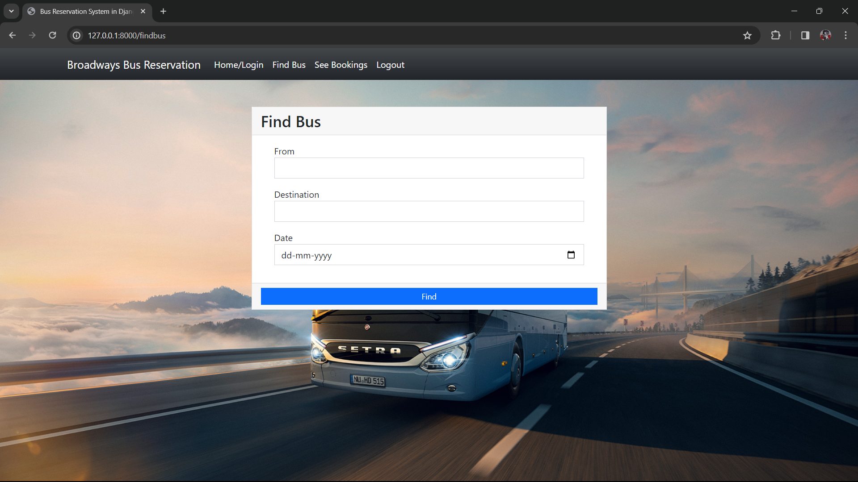
Service-Page

Slide 12
Future Enhancements:
Payment Integration: Integrate payment gateways to enable online payment for seat reservations.
Real-Time Updates: Implement real-time updates for seat availability and reservation status using technologies like Web Sockets.
Mobile App: Develop a companion mobile application for users to access the system on their smartphones.
Localization: Add support for multiple languages to make the system accessible to a wider audience.
Feedback System: Incorporate a feedback system to gather user reviews and improve service quality.

Slide 13
Conclusion
The Bus Reservation System project demonstrates the use of Python and Django framework to build a robust web application for managing bus reservations effectively. With its intuitive user interface and comprehensive features, the system aims to streamline the process of booking bus tickets and enhance the overall user experience.
Source :

Slide 14
Thank You!
Notes:
Thank You !!

